Slide 1
Substance Abuse Prevention
“Where there is life there is hope”
-Ron Grover

Slide 2
What is a drug?
Pause for Discussion
Notes:
A substance other than food that changes the structure or function of the body or mind

Slide 3
Are all drugs bad for your body?
Pause for Discussion
Notes:
All medicines are drugs but not all drugs are medicine. All types of drugs, including medicines can be misused or abused

Slide 4
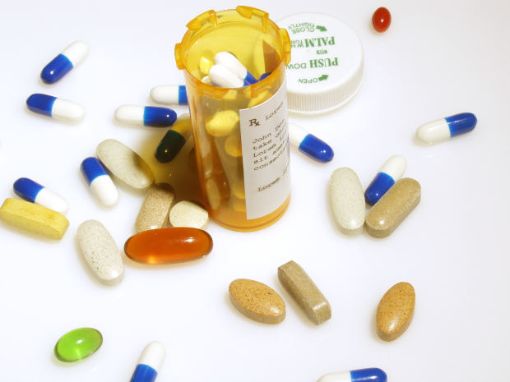
Drug Misuse
Taking or using a medicine in a way that it is not intended
Using a drug without following the instructions on the label
Using a drug not prescribed to you
Allowing someone else to use a drug prescribed to you
Taking more of a drug than the doctor prescribed
Using the drug longer than advised by your doctor
Source: Pixbay

Slide 5
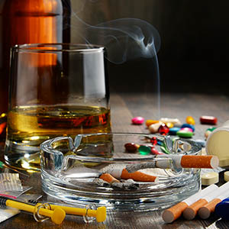
Drug Abuse
Intentionally using drugs in a way that is unhealthful or illegal
When someone is using illegal drugs they are abusing drugs
When someone uses legal drugs for nonmedical person they are abusing drugs
Misusing and abusing drugs can damage your body, lead to allergic reactions, illness or even death
Source: Pixbay

Slide 6
Teens and Drugs
Physical effects can include sleeplessness, memory loss, irritability, nausea heart failure or stroke
Social effects include changes in personality, mood swings or even violence
Mental and emotional effects include interfering with the ability to think, confusion, inability to handle emotions, depression and anxiety
The use of illegal drugs can have serious health consequences during the teens years
Drugs are especially harmful to teens because your body is rapidly growing
The teenage brain is more susceptible to addiction and have long term cognitive effects

Slide 7
Application: Definition Exploration
Get your writing utensil and a piece of paper
Travel throughout the room to write each of the definitions for the words
Return back to your seat when you finish
Pause Now to Write

Slide 8
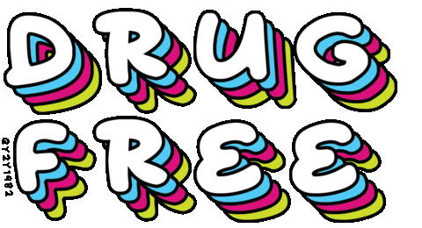
Exit Ticket
Name two reasons why drug use is especially harmful to teens.
Source: giphy.com

